Slide 1
Hashing Exercises

Slide 2
Exercises
Table Size 13
Hash- mod 13
Insert 19, 10, 12, 11, 13, 26, 14, 24
Linear Probe
Quadratic Probe
Rehash – mod 11

Slide 3
Exercise 1
Linear probe
Insert 19, 10, 12, 11, 13, 26, 14, 24
How many probes?
0
1
2
3
4
5
6
7
8
9
10
11
12

Slide 4
Exercise 1
Linear probe
Insert 19, 10, 12, 11, 13, 26, 14, 24
How many probes?
15
0 | 13
1 | 26
2 | 14
3 | 24
4
5
6 | 19
7
8
9
10 | 10
11 | 11
12 | 12

Slide 5
Exercise 2
Quadratic probe
Insert 19, 10, 12, 11, 13, 26, 14, 24
How many probes?
0
1
2
3
4
5
6
7
8
9
10
11
12

Slide 6
Exercise 2
Quadratic probe
Insert 19, 10, 12, 11, 13, 26, 14, 24
How many probes?
13
0 | 13
1 | 26
2 | 14
3
4
5
6 | 19
7 | 24
8
9
10 | 10
11 | 11
12 | 12

Slide 7
Exercise 3
Rehash
Insert 19, 10, 12, 11, 13, 26, 14, 24
How many probes?
0
1
2
3
4
5
6
7
8
9
10
11
12

Slide 8
Exercise 3
Rehash- mod 11
Insert 19, 10, 12, 11, 13, 26, 14, 24
How many probes?
11
0 | 13
1 | 14
2 | 24
3
4 | 26
5
6 | 19
7
8
9
10 | 10
11 | 11
12 | 12

Slide 9
Hash Table Uses
In C++ an array must be declared with a size
Indexes are the integers 0 to size-1
Not all languages are like this
PHP, Python, Perl, Javascript

Slide 10
Languages
They allow:
string arr[];
arr[“firstName”]=“Jane”;
arr[“lastName”]=“Doe”;
arr[“ethnicity”]=“White”;

Slide 11
Array Storage
Array is a block of memory
The name hold the beginning address

Slide 12
[ ] Operator
Typically using [n] will add the beginning address with n*sizeof(data-type) to get the memory address
This operator is overloadable

Slide 13
Overloading [ ]
In PHP, Python, Perl, and Javascript the [ ] operator is overloaded to first hash the string index to determine the position in the array

Slide 14
Overloading [ ]
You will be doing this for your next assignment
You will be given most of the code for a hash table
You will also be given an Array class
This has a data array, and a hash table

Slide 15
Assignment
You will finish the [ ] overload I started so that it uses the hash table to look for the key
If it finds the key, return your data array at the position it was found
If it isn’t found, insert the key into the hash table and return the data array at the position the key was inserted
This is how they allow us to create indexes on the fly

Slide 16
How it works
arr[“fName”]=“Jane”;
arr[“lName”]=“Doe”;
arr[“ethnic”]=“White”;
 | Array
0
1
2
3
4
5
6
7
8
9
 | Hash Table
0
1
2
3
4
5
6
7
8
9

Slide 17
Assignment
You will also need to finish the functions that return the step for the 3 collision resolution functions
Linear
Quadratic
Rehash
Get some running results and make a graph
Write a brief report
More details coming soon.

Slide 18
Priority Queues
Chapter 6

Slide 19
Queues
Keep order by priority
LIFO- Last in first out (stack)
FIFO- First in first out (typical queue)
Also have min and max queues

Slide 20
Priority Queues
Max priority
Want to pop the largest value
Min priority
Want to pop the smallest value

Slide 21
Priority Queues
Insert is normal, but delete is our pop
Delete must find the min/max value and remove it

Slide 22
Priority Queues
Implementations?

Slide 23
Priority Queues
Implementations?
BST
Ordered Array
Unordered Array
Ordered Linked List
Unordered Linked List

Slide 24
Priority Queues
Complexities
BST
Insert O(n) Delete O(n)
Not good, especially considering a series of deletes
Ordered Linked List
Insert O(n) Delete O(1)
Unordered Linked List
Insert O(1) Delete O(n)
Arrays are similar to linked lists

Slide 25
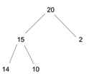
Heaps
Heaps are often used for priority queues
Heap is a binary tree
Complete – every level full but the last
Children are smaller (min)/larger (max) than the parent

Slide 26
Operations
Insert
O(log n) because the height of the tree is exactly log n
Delete
O(1) to get the min/max because it is at the root
Fixing the heap may be O(log n) though

Slide 27
Inserting
Place it in the next open position
Move it upward through swaps if necessary to maintain priority/order

Slide 28
Insert
Insert 5

Slide 29
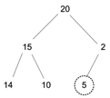
Insert
Insert 5

Slide 30
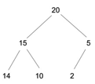
Insert
Insert 5

Slide 31
Insert
Insert 21

Slide 32
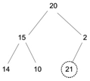
Insert
Insert 21

Slide 33
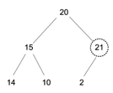
Insert
Insert 21

Slide 34
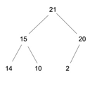
Insert
Insert 21

Slide 35
Deleting
Remove the root
Fill it with the last filled position
Swap down if necessary to maintain priority/order

Slide 36
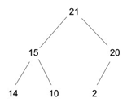
Delete

Slide 37
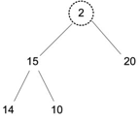
Delete

Slide 38
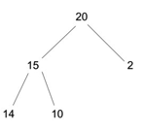
Delete

Slide 39
Delete Again

Slide 40
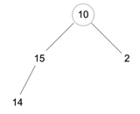
Delete Again

Slide 41
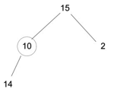
Delete Again

Slide 42
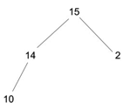
Delete Again

Slide 43
Creating a Heap
Create your heap through a series of insertions
You would expect an insertion to be log n average, but on average it is usually less. Experiments suggest that on average an element swaps to move up 1.6 levels.

Slide 44
Storage
To be more efficient, we don’t want to use pointers
They are complete, so we can store them in an array
This is an implicit data structure because there is no special structure needed for a heap. Thus, no space overhead.

Slide 45
Storage
Heaps are stored as an array
Root is at 0, then put in the left child and the right
0
1
2
3
4
5
6
7
8
9

Slide 46
Storage
Heaps are stored as an array
Root is at 0, then put in the left child and the right
0 | 21
1 | 15
2 | 20
3 | 14
4 | 10
5 | 2
6
7
8
9

Slide 47
Storage
How do you find children?
0 | 21
1 | 15
2 | 20
3 | 14
4 | 10
5 | 2
6
7
8
9

Slide 48
Storage
How do you find children?
Left at 2*index +1
Right at 2*index + 2
0 | 21
1 | 15
2 | 20
3 | 14
4 | 10
5 | 2
6
7
8
9

Slide 49
Storage
Can also start the array at index 1 to simplify things (done this way in the book)
Left at 2*index
Right at 2*index + 1
0
1 | 21
2 | 15
3 | 20
4 | 14
5 | 10
6 | 2
7
8
9

Slide 50
Storage
Find a parent?
(Index -1) / 2
0 | 21
1 | 15
2 | 20
3 | 14
4 | 10
5 | 2
6
7
8
9

Slide 51
Storage
Find a parent?
Index/2
0
1 | 21
2 | 15
3 | 20
4 | 14
5 | 10
6 | 2
7
8
9

Slide 52
Heaps
Within the array, there is not a lot of order, so finding a particular element is not easy
If it is a min heap, finding the max is very expensive too

Slide 53
d-Heaps
A heap with d kids
Shallow depth, more bushy
Good for insertion
Bad for deletion, have to look at d kids

Slide 54
Merging Heaps
For the ones we have talked about so far, it is really expensive
Why?

Slide 55
Leftist Heaps
6.6

Slide 56
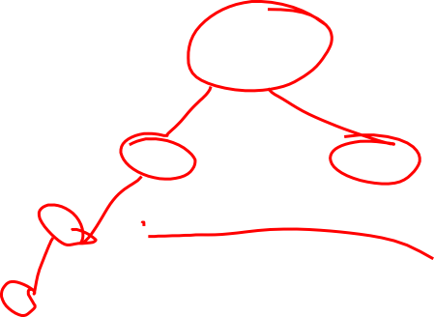
Leftist Heap
It is a heap, but not a complete heap
What is complete?
All levels must be full but last, last must be filled from left to right
This red drawing is leftist, not complete

Slide 57
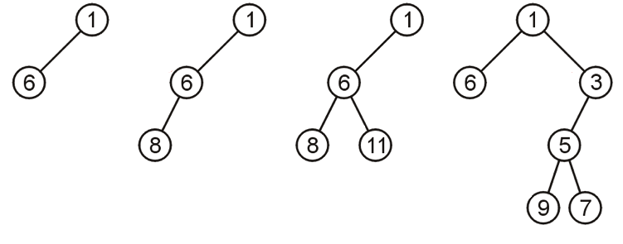
Null Path Length
A Null path length is the shortest path length from a node to null.

Slide 58
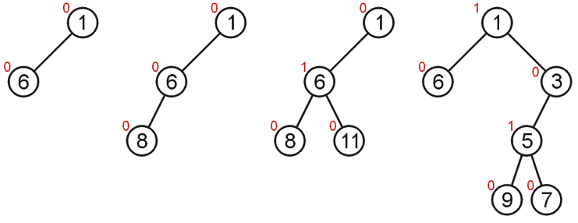
Null Path Length

Slide 59
Leftist Heap
Both sub-tress must be leftist heaps
The null path length of the left sub-tree must be greater than or equal to the null path length of the right.

Slide 60
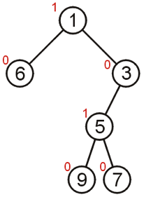
Leftist Heap
Usually leftist heaps have more nodes in the left sub-tree, but not always.

Slide 61
Merging
This is what is good about leftist heaps
How do we do it?

Slide 62
Merging
This is what is good about leftist heaps
How do we do it?
Choose the smaller of the two roots (if min)
Cut off its right tree
The new right tree is the recursive merge of the old right and the other tree

Slide 63
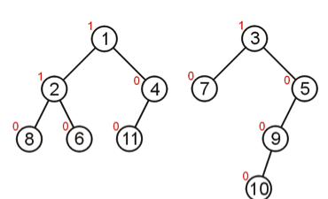
Merging

Slide 64
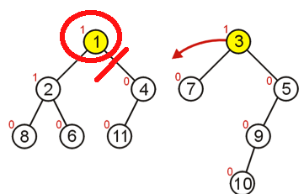
Merging

Slide 65
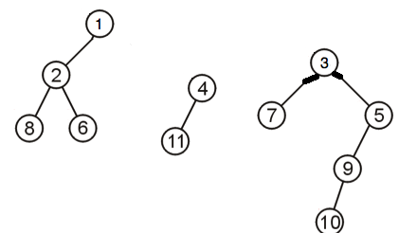
Merging

Slide 66
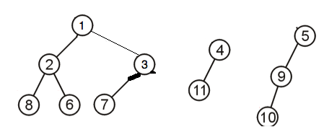
Merging

Slide 67
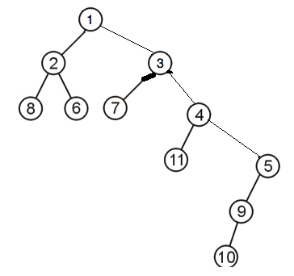
Merging

Slide 68
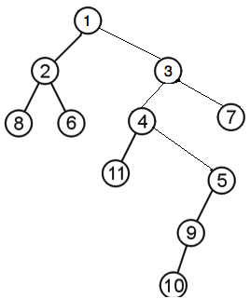
Merging

Slide 69
Operations
The merge can be used for other operations
Insert- merge the tree with the tree made up of the single new node
Delete- delete the root, then call merge on the two children trees

Slide 70
Insert
Insert 13

Slide 71
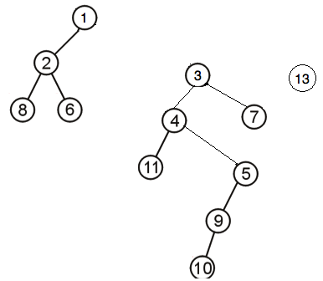
Insert
Insert 13

Slide 72
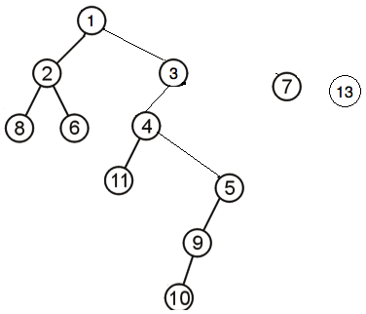
Insert
Insert 13

Slide 73
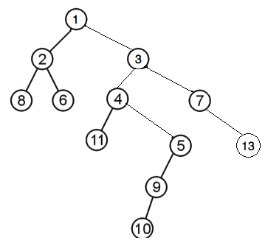
Insert
Insert 13

Slide 74
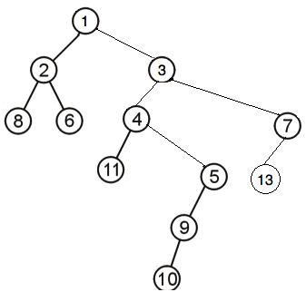
Insert
Insert 13 final result

Slide 75
Delete
Delete

Slide 76
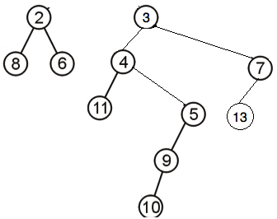
Delete
Delete
After delete min (the 1 at the root)
Now merge two remaining trees

Slide 77
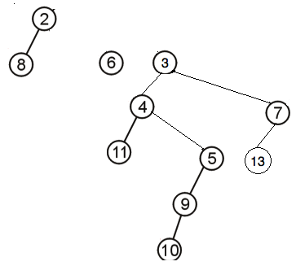
Delete
Delete
Take 2 as root and chop it’s right child, the new right is the smaller of 6 and 3

Slide 78
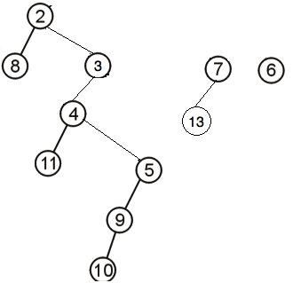
Delete
Delete
3 was smaller, so we took it as the right child of 2, and chopped its right, the new right is the smaller of 7 and 6

Slide 79
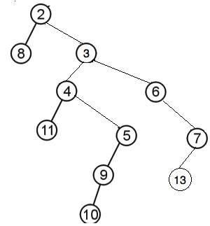
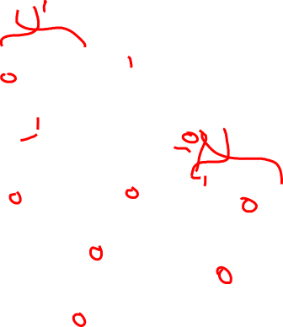
Delete
Delete
After taking 6 as the child of 3, there was no right to chop, so we attached 7

Slide 80
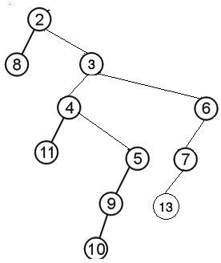
Delete
Delete
Starting at 6 (the last one that we changed the children of) we check to make sure the children follow leftist properties, if they don’t, swap them
6’s didn’t, so we swapped them

Slide 81
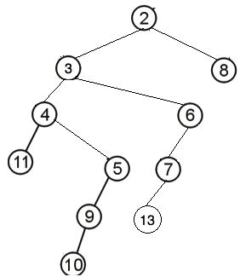
Delete
Delete
3’s left child had a greater null path length that the right, so we didn’t swap them
2’s left child had a shorter null path length than the right, so we swapped them

Slide 82
Complexity
What is the complexity?

Slide 83
Complexity
What is the complexity?
The leftist property requires the tree be semi-balanced
Merges are log n

Slide 84
Other Operations
We don’t do any other operations on leftist heaps
Why?

Slide 85
Other Operations
We don’t do any other operations on leftist heaps
Why?
Because the other operations are O(n) because the heap isn’t set up to optimize them

Slide 86
Storage
Stored as nodes and pointers
Not in an array, why?

Slide 87
Storage
Stored as nodes and pointers
Not in an array, why?
Because it is not complete, and there would be a lot of wasted empty array positions.

Slide 88
Skew Heap 6.7
A heap that tries to accomplish the same results as a leftist heap, but aims to reduce the overhead of storing or re-computing null path lengths

Slide 89
Operations
Operations are the same as the leftist heap
Merging is the only difference

Slide 90
Merging
On the way down, it is the same as the leftist heap
Choose the smaller of the two roots (if min)
Cut off its right tree
The new right tree is the recursive merge of the old right and the other tree
But, on the way back up, instead of only swapping to fix the leftist property, we always swap.

Slide 91
Merge
The idea of swapping is that it keeps the right tree from getting too large.
Amortized analysis gives a complexity of log n

Slide 92
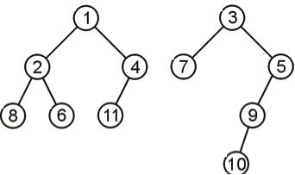
Merging

Slide 93
Merging

Slide 94
Merging

Slide 95
Merging

Slide 96
Merging
Then on the way back out, always swap

Slide 97
Merging
Then on the way back out, always swap
Start at 4 because we changed the right child

Slide 98
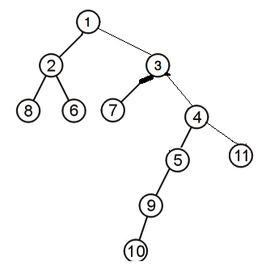
Merging
Then on the way back out, always swap
Now do 3

Slide 99
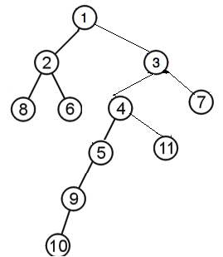
Merging
Then on the way back out, always swap
Now do 1

Slide 100
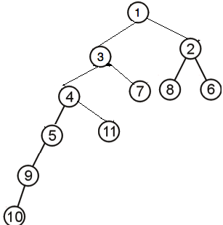
Merging
Final result

Slide 101
Binomial Queues 6.8
Another alternative to the complete heap
Better merge complexity O( log n)

Slide 102
Binomial Queue
A binomial queue is a tree
A single node tree is a binomial tree of height 0
A binomial tree with height k is formed by attaching a binomial tree of height k-1 to the root of a binomial tree of height k-1

Slide 103
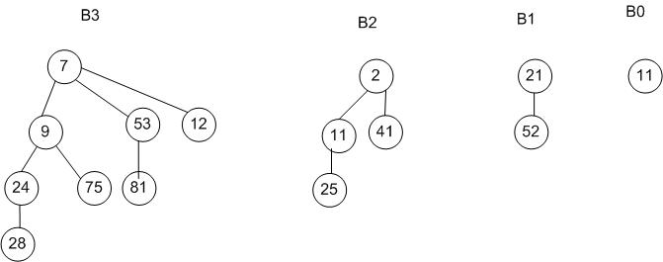
Binomial Queues
Examples

Slide 104
Binomial Queue
How many nodes are in a tree of height k?
How many children does the root have?
What kind of binomial trees make up the children?

Slide 105
Binomial Queue
How many nodes are in a tree of height k? 2^k
How many children does the root have? k
What kind of binomial trees make up the children?
There are children of height 0, 1, 2, …. k-1

Slide 106
Binomial Forests
Because a queue can only be of size 2^x, we need multiple queues to store any number of nodes
The implementation does not use a single tree, but several trees that we call a forest
Every tree in the forest is a binomial queue

Slide 107
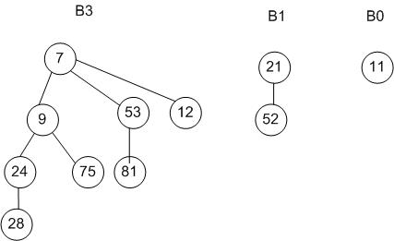
Binomial Forest
This is an example of a queue holding 11 nodes

Slide 108
Binomial Forest
Finding min requires we search each root in the forest

Slide 109
Merging
Look for trees of the same size and merge them
If doing a min queue, make the smaller the root, then make the root of the other tree a child
Best to start with the smallest trees

Slide 110
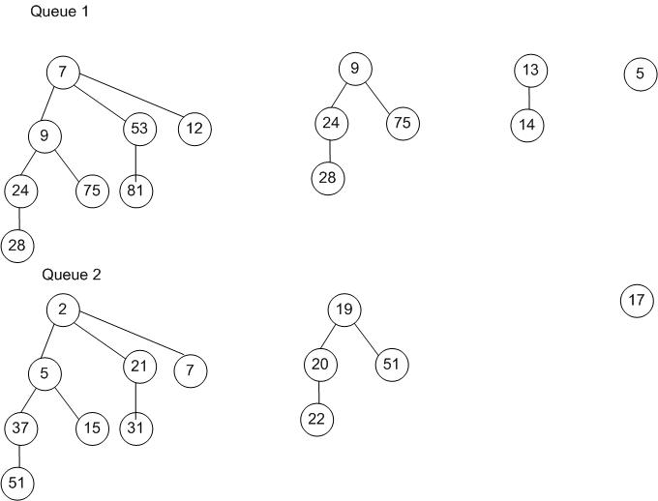
Merging

Slide 111
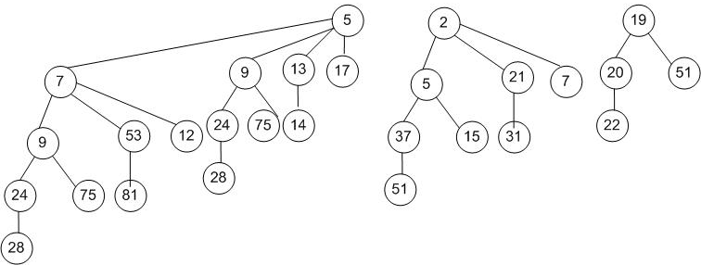
Merging
May end up with this:

Slide 112
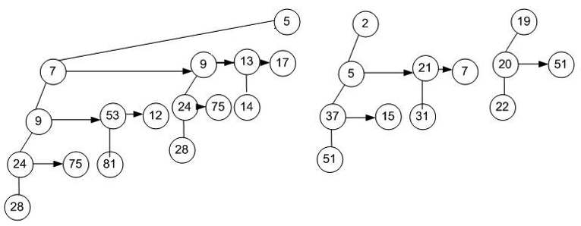
Implementation
Difficult to allow any number of children
Use sibling pointers

Slide 113
Insert
Insert 18 and 1

Slide 114
Delete

Slide 115
Duplicates
So far, in our data structures, we have not allowed duplicates
Heaps and queues allow duplicates, why?

Slide 116
Duplicates
So far, in our data structures, we have not allowed duplicates
Heaps and queues allow duplicates, why?
Because it is very possible that two items have the same priority
Consider a max queue for USU scholarships, if two people have the same GPA and ACT score, they will have the same priority

